Slide 1
Data Structures so far...
Array is a good static data structure that can be accessed randomly and is fairly easy to implement.
Linked Lists on the other hand is dynamic and is ideal for application that requires frequent operations such as add, delete, and update.
One drawback of linked list is that data access is sequential.
Notes:
Then there are other specialized data structures like, stacks and queues that allows us to solve complicated problems using these restricted data structures.

Slide 2
Disadvantage of sequential data structures:
Time to search is directly proportional to data in data structure.
Therefore it seems that more efficient data structures are needed to store and search data.
Notes:
For example, if the size of the data set is n, then the number of comparisons needed to find an item may be as bad as some multiple of n.*
* So imagine doing the search on a linked list (or array) with n = 106 nodes. Even on a machine that can do million comparisons per second, searching for m items will take roughly m seconds. This not acceptable in today’s world where speed at which we complete operations is extremely important.

Slide 3
Trees
Tree is a hierarchical data structure which stores the information naturally in the form of hierarchy style.
It represents the nodes connected by edges.
A tree is a nonlinear data structure.
Notes:
We can extend the concept of linked data structure (linked list, stack, queue) to a structure that may have multiple relations among its nodes. Such a structure is called a tree.

Slide 4
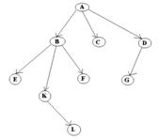
General Properties of Trees
One node is distinguished as a root
Every node (except root) is connected by a directed edge from exactly one other node. A direction is: parent -> children
Here, A is a parent of B, C, D,
B is called a child of A.
on the other hand, B is a parent of E, F, K

Slide 5
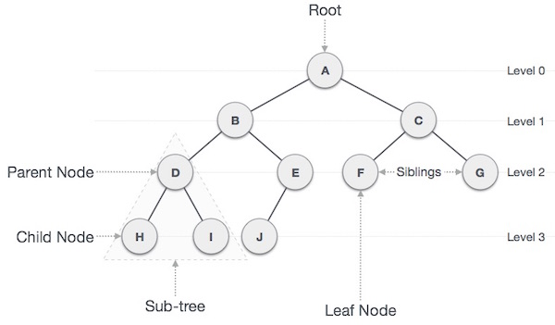
General Terms of Trees
Keys
Visiting
Traversing
Notes:
*Internal nodes have at least one child.

